Slide 1


Noida Institute of Engineering and Technology, Greater Noida
Full-Stack Web Development using Laravel with Vue.js
Unit: 5
Deployment Laravel Application to Production
Rajat Kumar
(Asst. Professor)
CSE Department
Course Details (B. Tech. 6th Sem)

Slide 2

Brief Introduction of Faculty
COURSE | BOARD/UNIVERSITY | YEAR OF PASSING
M.Tech | ITM, AKTU, Lucknow | 2020
B.Tech | ITM, AKTU, Lucknow | 2016
Certificate of Recognition for role as Faculty in MOOCs Course Python/CSS from E & ICT Academy, IIT Kanpur.
Worked on Internet of things (IoT) technology under the topic Energy efficient technique for data aggregation in M.Tech.
Published paper in International journal of research in electronics and computer engineering (IJRECE) on “Energy efficient technique for data aggregation in IoT” (April-June 2019).
Area of Interest: FullStack Development, Machine Learning, IOT

Slide 3
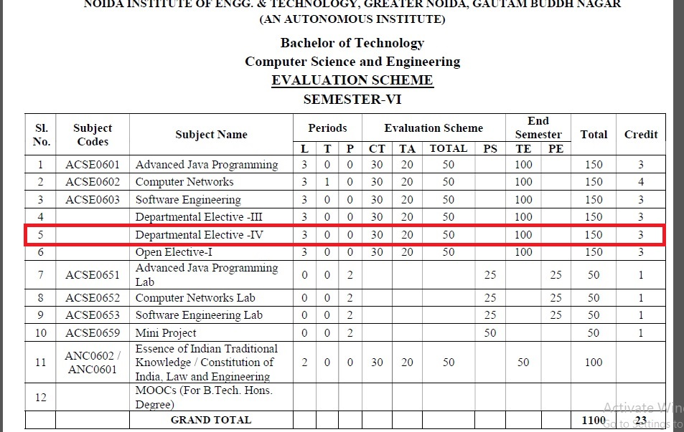
Evaluation Scheme

Slide 4
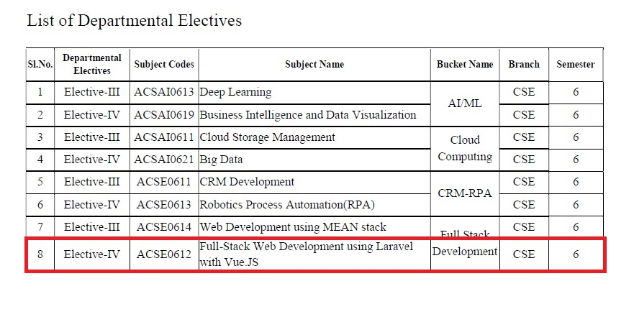
Evaluation Scheme

Slide 5
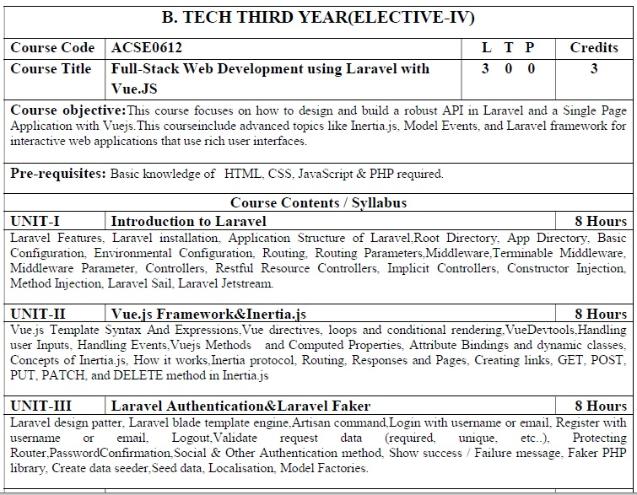
Syllabus

Slide 6
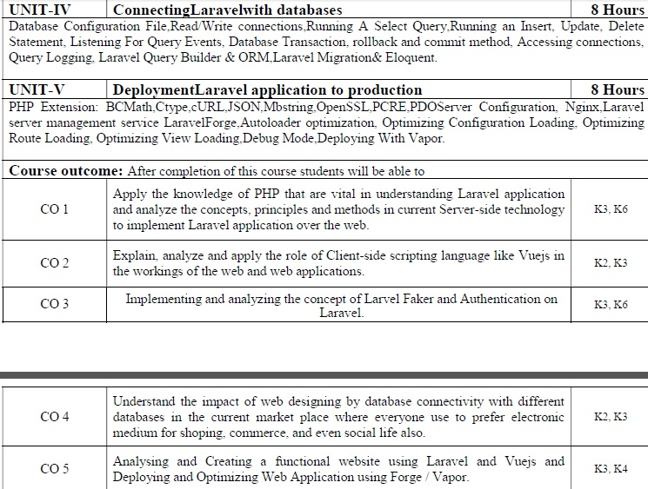
Syllabus

Slide 7
Branch Wise Application
1. Real time web analytics
2. Digital Advertising
3. E-Commerce
4. Publishing
5. Massively Multiplayer Online Games
6. Backend Services and Messaging
7. Project Management & Collaboration
8. Real time Monitoring Services
9.Live Charting and Graphing
10. Group and Private Chat

Slide 8
Course Objective
In this semester, the students will
Study how to use PHP for multiple applications.
Study concepts of Laravel with Vue.js
Study the concepts of Laravel Authentication and Faker.
Study the concepts of Laravel Connection with database.

Slide 9
Course Outcomes (COs)
At the end of course, the student will be able to:
CO 1: Apply the knowledge of PHP that are vital in understanding Laravel application and analyze the concepts, principles and methods in current Server-side technology to implement Laravel application over the web.
CO 2: Explain, analyze and apply the role of Client-side scripting language like Vuejs in the workings of the web and web applications.
CO 3: Implementing and analyzing the concept of Larvel Faker and Authentication on Laravel.
CO 4: Understand the impact of web designing by database connectivity with different databases in the current market place where everyone use to prefer electronic medium for shopping, commerce, and even social life also.
CO 5: Analysing and Creating a functional website using Laravel and Vuejs and Deploying and Optimizing Web Application using Forge / Vapor.

Slide 10
Program Outcomes (POs)
Engineering Graduates will be able to:
PO1 : Engineering Knowledge
PO2 : Problem Analysis
PO3 : Design/Development of solutions
PO4 : Conduct Investigations of complex problems
PO5 : Modern tool usage
PO6 : The engineer and society

Slide 11
Program Outcomes (POs)
Engineering Graduates will be able to:
PO7 : Environment and sustainability
PO8 : Ethics
PO9 : Individual and teamwork
PO10 : Communication
PO11 : Project management and finance
PO12 : Life-long learning

Slide 12

COs - POs Mapping
CO.K | PO1 | PO2 | PO3 | PO4 | PO5 | PO6 | PO7 | PO8 | PO9 | PO10 | PO11 | PO12
CO1 | 2 | 2 | 2 | 3 | 3 | - | - | - | - | - | - | -
CO2 | 3 | 2 | 3 | 2 | 3 | - | - | - | - | - | - | -
CO3 | 3 | 2 | 3 | 2 | 3 | - | - | - | - | - | - | -
CO4 | 3 | 2 | 3 | 2 | 3 | - | - | - | - | - | - | -
CO5 | 3 | 2 | 3 | 3 | 3 | - | - | - | - | - | - | -
AVG | 2.8 | 2.0 | 2.8 | 2.4 | 3.0 | - | - | - | - | - | - | -

Slide 13
Program Specific Outcomes(PSOs)
Sr. No. | PSO Description
PSO1 | The ability to identify, analyze real world problems and design their ethical solutions using artificial intelligence, robotics, virtual/augmented reality, data analytics, block chain technology, and cloud computing.
PSO2 | The ability to design and develop the hardware sensor devices and related interfacing software systems for solving complex engineering problems.
PSO3 | The ability to understand inter-disciplinary computing techniques and to apply them in the design of advanced computing.
PSO4 | The ability to conduct investigation of complex problems with the help of technical, managerial, leadership qualities, and modern engineering tools provided by industry-sponsored laboratories.

Slide 14
COs - PSOs Mapping
CO.K | PSO1 | PSO2 | PSO3 | PSO4
CO1 | 3 | - | - | -
CO2 | 3 | 3 | - | -
CO3 | 3 | 3 | - | -
CO4 | 3 | 3 | - | -
CO5 | 3 | 3 | - | -

Slide 15
Program Educational Objectives (PEOs)
Program Educational Objectives (PEOs) | PEOs Description
PEOs | To have an excellent scientific and engineering breadth so as to comprehend, analyze, design and provide sustainable solutions for real-life problems using state-of-the-art technologies.
PEOs | To have a successful career in industries, to pursue higher studies or to support entrepreneurial endeavors and to face the global challenges.
PEOs | To have an effective communication skills, professional attitude, ethical values and a desire to learn specific knowledge in emerging trends, technologies for research, innovation and product development and contribution to society.
PEOs | To have life-long learning for up-skilling and re-skilling for successful professional career as engineer, scientist, entrepreneur and bureaucrat for betterment of society.

Slide 16
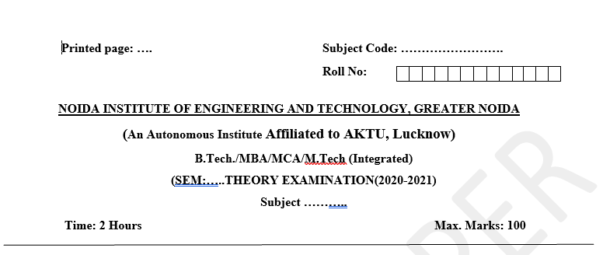
Pattern of Offline External Exam Question Paper (100 marks)

Slide 17
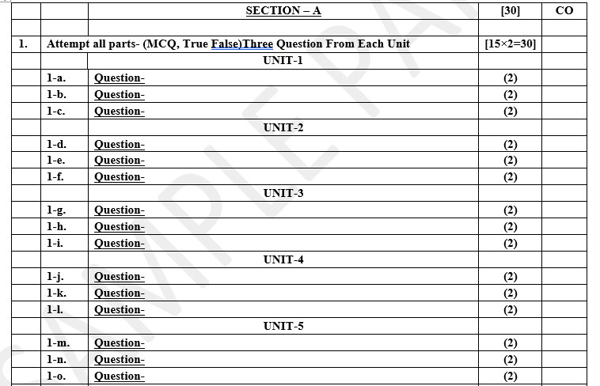
Pattern of Offline External Exam Question Paper (100 marks)

Slide 18
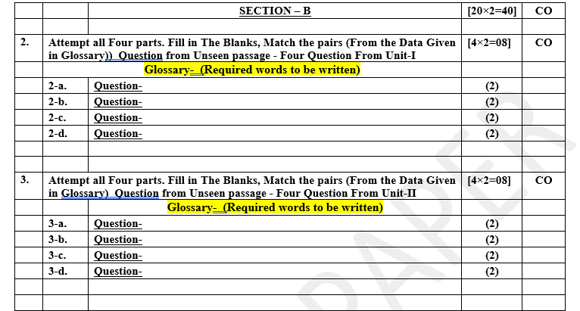
Pattern of Offline External Exam Question Paper (100 marks)

Slide 19
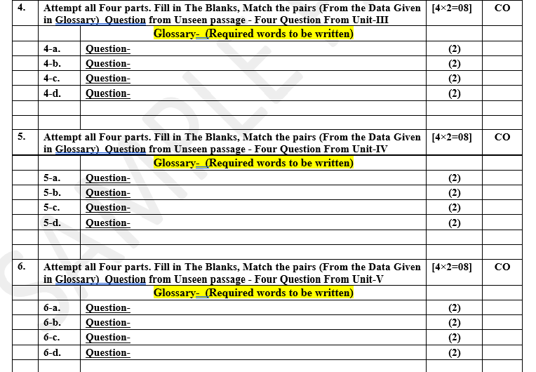
Pattern of Offline External Exam Question Paper (100 marks)

Slide 20
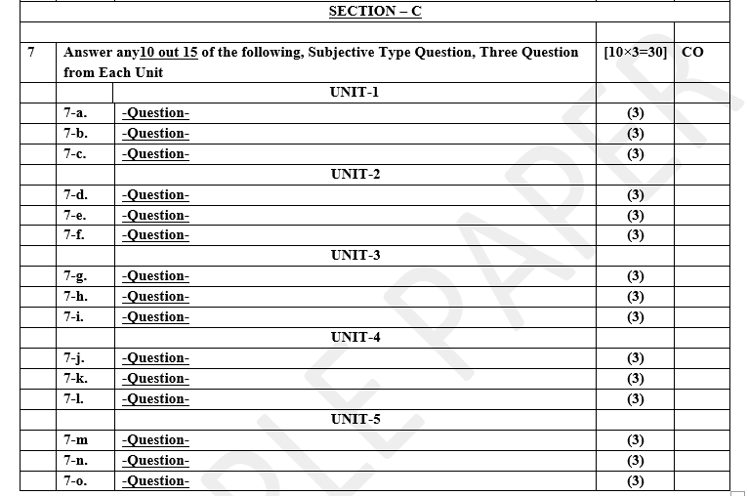
Pattern of Offline External Exam Question Paper (100 marks)

Slide 21

Result Analysis
Branch | Result
CSE | 100%
IT | 98%

Slide 22
Prerequisite / Recap
Student should have knowledge of object oriented analysis and design.
Knowledge of Core PHP.
knowledge of Programing language such as C/C++ etc.
Good problem solving Skill .

Slide 23
Brief Introduction about the Subject with videos
YouTube /other Video Links
https://youtu.be/rI4kdGLaUiQ?list=PL6n9fhu94yhUbctIoxoVTrklN3LMwTCmd
https://youtu.be/v9ejT8FO-7I?list=PLrhzvIcii6GNjpARdnO4ueTUAVR9eMBpc
https://youtu.be/VGLjQuEQgkI?list=PLt4nG7RVVk1h9lxOYSOGI9pcP3I5oblbx

Slide 24
Unit Content
PHP Extensions:
BC Math
Ctype
cURL
JSON
MbString
OpenSSL
PCRE
PDO Server Configuration
Nginx
Optimizing Route Loading
Optimizing View Loading
Deployment with vapor

Slide 25
Unit Objective
In Unit , the students will be able to find
Definitions of terms and concepts.
The idea of Laravel deployment.
Various PHP Extensions.

Slide 26
Topic Objective
Topic : PHP Extensions
In this topic, the students will gain the idea of various PHP extensions and deployment of Laravel with configuration management.

Slide 27
PHP Extension: BCMath
The BCMath extension in PHP stands for "Binary Calculator Math" and is used for arbitrary precision arithmetic. It allows PHP developers to perform mathematical operations on numbers with very high precision, which is especially useful when dealing with financial calculations or other scenarios where precision matters.
BCMath provides functions for arithmetic operations like addition, subtraction, multiplication, and division, as well as functions for more complex operations like exponentiation and square roots. Unlike standard arithmetic operators in PHP, BCMath functions operate on strings representing numbers, allowing for arbitrary precision calculations.
<?php
$num1 = '12345678901234567890.1234567890';
$num2 = '98765432109876543210.0987654321';
$result = bcadd($num1, $num2); // Add two numbers
echo $result; // Output: 111111111011111111100.2222222211
?>

Slide 28
BCMath
To use BCMath in PHP, you need to make sure it's enabled in your PHP configuration. This typically involves uncommenting or adding the line extension=bcmath.so (for Linux) or extension=php_bcmath.dll (for Windows) in your php.ini file and then restarting your web server or PHP service.

Slide 29
Ctype
The ctype PHP extension provides functions for testing the character types of strings. These functions are useful for tasks such as data validation, input sanitization, and character manipulation. The extension contains functions for checking whether a character or a string contains certain types of characters, such as alphabetic characters, digits, whitespace, punctuation, etc.

Slide 30
Ctype
Here are some common functions provided by the ctype extension:
ctype_alnum: Checks if all characters in a string are alphanumeric.
ctype_alpha: Checks if all characters in a string are alphabetic.
ctype_cntrl: Checks if all characters in a string are control characters.
ctype_digit: Checks if all characters in a string are decimal digits.
ctype_graph: Checks if all characters in a string are printable, excluding whitespace.
ctype_lower: Checks if all characters in a string are lowercase letters.
ctype_print: Checks if all characters in a string are printable.
ctype_punct: Checks if all characters in a string are punctuation characters.
ctype_space: Checks if all characters in a string are whitespace characters.
ctype_upper: Checks if all characters in a string are uppercase letters.
ctype_xdigit: Checks if all characters in a string are hexadecimal digits.

Slide 31
Ctype
<?php
$string = "Hello123";
if (ctype_alnum($string)) {
echo "The string contains only alphanumeric characters.";
}
if (ctype_upper($string)) {
echo "The string contains only uppercase letters.";
} elseif (ctype_lower($string)) {
echo "The string contains only lowercase letters.";
} else {
echo "The string contains both uppercase and lowercase letters.";
}
?>

Slide 32
Ctype
To use the ctype extension in PHP, it's usually enabled by default as part of the core PHP installation. However, if you need to explicitly enable it, you can do so by ensuring that extension=ctype.so (for Linux) or extension=php_ctype.dll (for Windows) is uncommented in your php.ini file and then restarting your web server or PHP service

Slide 33
cURL
The cURL PHP extension provides an interface to the cURL library, allowing PHP developers to make HTTP requests and interact with other network protocols like FTP, SMTP, and more. cURL stands for "Client URL Library", and it's widely used for sending and receiving data over various network protocols.
Here are some common tasks you can perform using the cURL extension in PHP:
Sending HTTP requests: You can send GET, POST, PUT, DELETE, and other types of HTTP requests to interact with web servers and APIs.
Handling response data: You can retrieve response headers, response bodies, and other information returned by the server.
Handling cookies: cURL allows you to send and receive cookies, making it possible to maintain sessions across multiple HTTP requests.
Handling authentication: You can perform basic authentication, digest authentication, and other types of authentication supported by cURL.
Uploading files: You can upload files to a server using HTTP POST requests with cURL.
Downloading files: You can download files from remote servers using HTTP GET requests with cURL.

Slide 34
cURL Functions
curl_close — Close a cURL session
curl_copy_handle — Copy a cURL handle along with all of its preferences
curl_errno — Return the last error number
curl_error — Return a string containing the last error for the current session
curl_escape — URL encodes the given string
curl_exec — Perform a cURL session
curl_getinfo — Get information regarding a specific transfer
curl_init — Initialize a cURL session
curl_multi_add_handle — Add a normal cURL handle to a cURL multi handle
curl_multi_close — Close a set of cURL handles
curl_multi_errno — Return the last multi curl error number
curl_multi_exec — Run the sub-connections of the current cURL handle

Slide 35
cURL Functions
curl_multi_getcontent — Return the content of a cURL handle if CURLOPT_RETURNTRANSFER is set
curl_multi_info_read — Get information about the current transfers
curl_multi_init — Returns a new cURL multi handle
curl_multi_remove_handle — Remove a multi handle from a set of cURL handles
curl_multi_select — Wait for activity on any curl_multi connection
curl_multi_setopt — Set an option for the cURL multi handle
curl_multi_strerror — Return string describing error code
curl_pause — Pause and unpause a connection
curl_reset — Reset all options of a libcurl session handle
curl_setopt_array — Set multiple options for a cURL transfer
curl_setopt — Set an option for a cURL transfer
curl_share_close — Close a cURL share handle

Slide 36
cURL Functions
curl_share_errno — Return the last share curl error number
curl_share_init — Initialize a cURL share handle
curl_share_setopt — Set an option for a cURL share handle
curl_share_strerror — Return string describing the given error code
curl_strerror — Return string describing the given error code
curl_unescape — Decodes the given URL encoded string
curl_upkeep — Performs any connection upkeep checks
curl_version — Gets cURL version information

Slide 37
JSON
The JSON PHP extension provides functions to work with JSON data within PHP. JSON (JavaScript Object Notation) is a lightweight data interchange format widely used for data exchange between a server and a web client, as well as for storing configuration data and transmitting structured data between different systems.
The JSON extension in PHP provides functions for encoding PHP data structures into JSON format and decoding JSON-encoded data back into PHP data types. This facilitates communication between PHP scripts and other systems or services that use JSON for data exchange.

Slide 38
JSON PHP
Here are some common functions provided by the JSON extension:
json_encode: Encodes a PHP value into a JSON string.
json_decode: Decodes a JSON string into a PHP value (object, array, string, etc.).
json_last_error: Returns the last error occurred during JSON encoding or decoding.
json_last_error_msg: Returns a string description of the last error occurred during JSON encoding or decoding.

Slide 39
Mbstring
The mbstring extension in PHP stands for "multibyte string" and is used for handling multibyte encodings such as UTF-8, which is crucial for supporting a wide range of languages and characters beyond the ASCII character set. This extension provides functions to manipulate multibyte strings in PHP, including functions for string encoding, decoding, splitting, and case conversion.
If you're working with multilingual text or text containing characters beyond the ASCII range, it's important to have the mbstring extension enabled in your PHP configuration. You can typically enable it by uncommenting or adding the following line in your php.ini configuration file:

Slide 40
Mbstring
While there are many languages in which every necessary character can be represented by a one-to-one mapping to an 8-bit value,
there are also several languages which require so many characters for written communication that they cannot be contained within the range a mere byte can code (A byte is made up of eight bits.
Each bit can contain only two distinct values, one or zero. Because of this, a byte can only represent 256 unique values (two to the power of eight)).
Multibyte character encoding schemes were developed to express more than 256 characters in the regular bytewise coding system.

Slide 41
Mbstring
When you manipulate (trim, split, splice, etc.) strings encoded in a multibyte encoding,
you need to use special functions since two or more consecutive bytes may represent a single character in such encoding schemes. Otherwise, if you apply a non-multibyte-aware string function to the string,
it probably fails to detect the beginning or ending of the multibyte character and ends up with a corrupted garbage string that most likely loses its original meaning.
mbstring provides multibyte specific string functions that
help you deal with multibyte encodings in PHP. In addition to that,
mbstring handles character encoding conversion between the possible encoding pairs.
mbstring is designed to handle Unicode-based encodings such as
UTF-8 and UCS-2 and many single-byte encodings for convenience

Slide 42
OpenSSL
The OpenSSL PHP extension provides an interface to the OpenSSL library, allowing PHP developers to perform various cryptographic operations such as encryption, decryption, digital signature generation and verification, secure connections over HTTPS, and more.
This extension is essential for applications that require secure communication over networks, handling encrypted data, implementing secure authentication mechanisms, and ensuring data integrity.

Slide 43
OpenSSL Configuration
To enable the OpenSSL extension in PHP, you typically need to:
Ensure that the OpenSSL library is installed on your system. This library is usually installed by default on most Unix-like systems (e.g., Linux, macOS), but you might need to install it manually on some platforms.
Enable the OpenSSL extension in your PHP configuration. You can typically do this by uncommenting or adding the following line in your php.ini configuration file:
After making changes to the php.ini file, you may need to restart your web server for the changes to take effect.
Once the OpenSSL extension is enabled, you can use PHP's built-in functions provided by the extension to perform various cryptographic operations. For example, you can use functions like openssl_encrypt() and openssl_decrypt() for symmetric encryption, openssl_sign() and openssl_verify() for digital signatures, and openssl_pkey_new() for generating cryptographic key pairs.

Slide 44
OpenSSL Functions
Sr.No | Function & Description | Version
1 | openssl_pkey_new()Returns a resource identifier that has new private and public key pair | 5.0.0
2 | openssl_pkey_get_private()Returns the private key | 5.0.0
3 | openssl_pkey_get_public()Returns the public key | 5.0.0
4 | openssl_​pkey_​export_​to_​file()Exports the key to a file | 5.0.0
5 | openssl_private_encrypt()Encrypts the data with the private key | 5.0.0
6 | openssl_public_encrypt()Encrypts the data with public key | 5.0.0
7 | openssl_public_decrypt()Decrypts the data with the public key | 5.0.0
8 | openssl_private_decrypt()Decrypts the data with the private key | 5.0.0

Slide 45
PCRE [Regular Expressions (Perl-Compatible)]
The PCRE (Perl Compatible Regular Expressions) PHP extension provides a powerful set of functions for working with regular expressions in PHP. Regular expressions are patterns used to match character combinations in strings, allowing for advanced text processing and manipulation.
PCRE is particularly useful when you need to perform tasks such as:
Searching for patterns within strings.
Replacing substrings based on patterns.
Validating input data against specific patterns or formats.
Extracting data from strings based on patterns.

Slide 46
Cont…
If you encounter any issues related to PCRE functions not being available, it may indicate a problem with your PHP installation, and you may need to recompile PHP with PCRE support or install the PCRE library on your system.
Once the PCRE extension is enabled, you can use PHP's PCRE functions like preg_match(), preg_replace(), preg_split(), and others to perform a wide range of text processing tasks using regular expressions.
Regular expressions are a powerful tool for string manipulation, but they can also be complex and tricky to get right. It's essential to understand regular expression syntax and best practices to effectively use PCRE functions in PHP.

Slide 47
PDO Server Configuration
Configuring PDO (PHP Data Objects) for server-side usage involves setting up both the PDO extension in PHP and configuring the database server.
PHP PDO Extension Configuration:
Ensure PDO Extension is Enabled: Make sure that the PDO extension is enabled in your PHP installation. You can check this by creating a PHP file with phpinfo() function and accessing it through a web browser. Look for the PDO section to confirm if it's enabled.
Database Driver: Decide which database driver you'll be using with PDO (e.g., MySQL, PostgreSQL, SQLite). Ensure that the corresponding PDO driver is installed and enabled in your PHP configuration. For example, if you're using MySQL, you need the pdo_mysql extension enabled.

Slide 48
PDO Server Configuration
Connection Parameters: Set up the connection parameters for your database. These typically include the database hostname or IP address, port number, database name, username, and password.
PDO DSN (Data Source Name): Construct a PDO DSN string that specifies the database driver, host, port, and database name. For example, for MySQL, the DSN might look like mysql:host=localhost;port=3306;dbname=mydatabase.
Database Server Configuration:
Database Setup: Ensure that the database server is installed and running. If not, install and configure the database server software (e.g., MySQL, PostgreSQL).
Database User: Create a database user with appropriate privileges to access the database. It's a security best practice to grant only the necessary permissions required by your application.
Firewall Configuration: If your database server is running on a separate machine, ensure that the firewall settings allow incoming connections on the database port.
Network Configuration: Configure your database server to accept connections from the PHP server. This might involve configuring network settings, such as binding the database server to a specific IP address or allowing remote connections.

Slide 49
Nginx
In Laravel deployment, Nginx serves as the web server that handles incoming HTTP requests and routes them to your Laravel application for processing. Nginx is responsible for efficiently serving static files, managing client connections, and directing PHP requests to the PHP interpreter for dynamic content generation.
Receiving Requests: When a user accesses your Laravel application through a web browser or an API client, their request is sent to the Nginx server.
Routing Requests: Nginx examines the request URL and determines how to handle it based on the server configuration. For Laravel applications, Nginx typically routes requests to the Laravel application's entry point, which is usually the index.php file in the public directory.
Serving Static Files: Nginx efficiently serves static files such as images, CSS, JavaScript, and other assets directly to clients without involving the PHP interpreter. This helps improve performance and reduce server load.

Slide 50
Nginx
Processing PHP Requests: When Nginx encounters a request for a PHP file, it passes the request to the PHP FastCGI Process Manager (FPM). PHP-FPM is responsible for executing PHP code and generating dynamic content.
Interacting with Laravel: Once PHP-FPM receives a PHP request, it loads the Laravel framework and routes the request to the appropriate controller or route defined in your Laravel application. Laravel processes the request, interacts with the database, and generates the response.
Returning Responses: After processing the request, Laravel sends the response back to PHP-FPM, which passes it back to Nginx. Nginx then sends the response to the client that made the initial request.

Slide 51
Autoloader Optimization
Autoloader optimization in Laravel deployment refers to the process of optimizing the autoloading mechanism provided by Composer, which is the PHP dependency manager used by Laravel.
In Laravel applications, Composer manages the autoload process by generating an optimized autoloader file based on the class mappings defined in the composer.json file and the vendor directory where Composer installs dependencies.
Autoloader optimization is essential for improving the performance of your Laravel application, especially in production environments where response time and server resources are critical. By optimizing the autoloader, you can reduce the time it takes for PHP to locate and load classes, leading to faster response times and improved overall performance.

Slide 52
Autoloader Optimization
Here's how autoloader optimization works in Laravel deployment:
Composer Autoload Optimization: Laravel provides an Artisan command named optimize that you can run to optimize the Composer autoloader. This command performs several tasks, including classmap generation and optimizing the Composer autoloader configuration.
php artisan optimize
This command generates a bootstrap/cache/compiled.php file that contains a class map of all the classes used in your application. This class map helps PHP locate classes more efficiently, reducing the overhead of autoloading individual files.
Classmap Generation: The optimize command generates a class map that maps each class name to its corresponding file path. This class map is then used by PHP's autoloader to quickly locate and load classes when they are referenced in your application.

Slide 53
Cont…
Caching Autoload Files: Additionally, Laravel caches the optimized autoloader files in the bootstrap/cache directory. This cached autoloader file is loaded automatically when your application starts, eliminating the need for Composer to parse and process the composer.json file and autoload files on every request.
Improved Performance: By optimizing the autoloader, Laravel reduces the number of file system operations required to load classes, resulting in faster application startup times and improved response times for incoming requests.

Slide 54
Optimizing Route Loading
To optimize or improve the speed of your application you will also need to optimize your route loading. This is very important, especially for applications with many routes.
Optimizing route loading in Laravel deployment refers to the process of improving the performance and efficiency of how Laravel loads and processes routes within your application. Routes in Laravel define the entry points for incoming HTTP requests and map them to specific controller actions or closures.
Route caching
To optimize route loading, you will need to run the following command while deploying your application to the live server:
php artisan route:cache

Slide 55
Cont…
This above command makes all your hundreds of routes into a single method in a cached file, and thereby boosts the registration performance of hundreds of routes.
Note: You must convert closure routes to controller classes if you want to use route caching.
If you want to clear the route cache, you can run the following command:
php artisan route:clear

Slide 56
Optimizing View Loading
When it comes to the deployment of a Laravel application to a live server, there are a few things you need to do. One of these is optimizing how the view will load.
Command
When sending your application to a live server, you need to ensure you run the view:cache artisan command amid your deployment process:
php artisan view:cache
This command precompiles all your Blade views so they are not compiled on demand, which improves the performance of each request that returns a view. It also clears the previous view cache to recompile new views. In other words, this quick and simple process will enhance the performance of your application.

Slide 57
Debug Mode
In Laravel deployment, Debug Mode refers to the configuration setting that controls whether detailed error messages and stack traces are displayed to the user when an error occurs. Debug Mode is typically enabled during development to aid in identifying and fixing issues quickly. However, it should be disabled in production environments for security and performance reasons.

Slide 58
Cont…
Enable Debug
Laravel provides APP_DEBUG flag in .env file to handle application debug mode, default it true and when you change to false it means you are disabling debug mode.
Search APP_DEBUG key in .env file and change true to enable debug mode and false for disable debug mode.
APP_NAME=Laravel
APP_ENV=local
APP_KEY=
APP_DEBUG=true
APP_URL=http://localhost
LOG_CHANNEL=single

Slide 59
Cont…
Disable Debug
Set the APP_DEBUG environment variable value to false in the .env environment configuration file.
APP_NAME=Laravel
APP_ENV=local
APP_KEY=
APP_DEBUG=false
APP_URL=http://localhost
LOG_CHANNEL=single

Slide 60
Cont…
Enable or disable debug mode using app.php
Open the app.php file located in your config/app.php laravel project. Search for debug key and change true to enable debug mode and false for disabling debug mode default it will show false.
'debug' => env('APP_DEBUG', false),
Enable Debug
'debug' => env('APP_DEBUG', true),
Disable Debug
'debug' => env('APP_DEBUG', false),

Slide 61
Deploying to Laravel Vapor
Laravel Vapor has its own CLI command that will let you deploy your various Vapor environments.
Chipper CI does not install the vapor command globally.
We assume instead that most projects include Vapor as a composer dependency.
For most projects, this means that you can simply use the vapor command as it's likely present at ./vendor/bin/vapor (remember, ./vendor/bin is set in $PATH).

Slide 62
Cont…
Deploying from Vapor in Chipper CI has two steps:
Set a VAPOR_API_TOKEN environment variable in the project settings
This can be generated within the Vapor API settings dashboard
Within your build pipeline, run one of the following commands
# Most simply, deploy your "production" environment
vapor deploy production
# Optionally, add some related data to the deployment
vapor deploy production --commit="${CI_COMMIT_SHA}" --message="${CI_COMMIT_MESSAGE}"

Slide 63
Cont…
Deploying Environments
If you would like to deploy to different Vapor environments depending on the branch, tag, or even commit message you can use some custom logic within your pipeline.
For example, here's a way to deploy to production versus staging:
# Deploy to a different environment depending on the branch
if [[ $CI_COMMIT_BRANCH == 'master' ]]; then
vapor deploy production
fi
if [[ $CI_COMMIT_BRANCH == 'develop' ]]; then
vapor deploy staging
fi

Slide 64
Laravel forge
Laravel Forge is a service provided by Laravel that simplifies the process of deploying and managing Laravel applications on cloud servers. It is designed to make server provisioning, deployment, and maintenance easier for developers, particularly those who are not specialized in server administration.
Key features and functionalities of Laravel Forge include:
Server Provisioning: Forge allows you to provision servers on popular cloud platforms such as DigitalOcean, AWS, Linode, and others. You can select your preferred server size, location, and operating system directly from the Forge dashboard.
Deployment: Forge supports automated deployment of Laravel applications from popular version control systems like Git repositories (GitHub, GitLab, Bitbucket). Once a server is provisioned, Forge can automatically pull your code and set up the necessary environment for your Laravel application.

Slide 65
Laravel forge
SSL Certificate Management: Forge simplifies the process of securing your application with SSL certificates. It can automatically obtain and configure Let's Encrypt SSL certificates for your domain names.
Database Management: Forge integrates with popular database services like MySQL, PostgreSQL, and MariaDB. It allows you to easily create and manage databases for your application from the Forge dashboard.
Queue Workers and Scheduler: Forge provides tools to manage queue workers (using tools like Redis or Beanstalkd) and schedule tasks (using Laravel's task scheduler) directly from the dashboard.
Monitoring and Notifications: Forge provides basic server monitoring and alerting features. It can notify you via email or Slack when certain events occur, such as server downtime or high resource usage.
Server Configuration: Forge handles server configuration tasks such as setting up Nginx or Apache web servers, PHP versions, and other necessary dependencies for Laravel applications.
Collaboration and Team Access: Forge supports team collaboration by allowing multiple users to access and manage servers. You can control user permissions and access levels.

Slide 66
Daily Quiz
Q1. Which company invented Vue.js?
Facebook
Google
Oracle
Twitter
Q 2 - Which of the following data binding interpolation is also known as "Mustache" syntax?
v-on
v-model
{{}}
[]
Q 3 - Which of the following is the correct way to install Vue.js in your project?
We can install Vue.js by using CDN by including <script> tag in HTML file.
We can install Vue.js by using Node Package Manager (NPM).
You can install Vue.js using Bower.
All of the above.

Slide 67
Daily Quiz
Q 4 Which of the following is the correct syntax to use for loop in Vue.js?
vFor
v-for
*v-for
None of the above.
Q 5 - Which of the following syntax is correct for creating a Vue.js instance?
var text = new object ({//options})
var text = new class ({//options})
var text = new text ({//options})
var text = new Vue({// options })

Slide 68
Weekly Assignment
Elaborate the term BCMath and Ctype.
Explain the concept of cURL and JSON.
Discuss about PDO Server Configuration.
Elaborate Nginx and Laravel server management.
Show your understanding about Debug mode and Deployment with Vapor

Slide 69

Old Question Paper

Slide 70
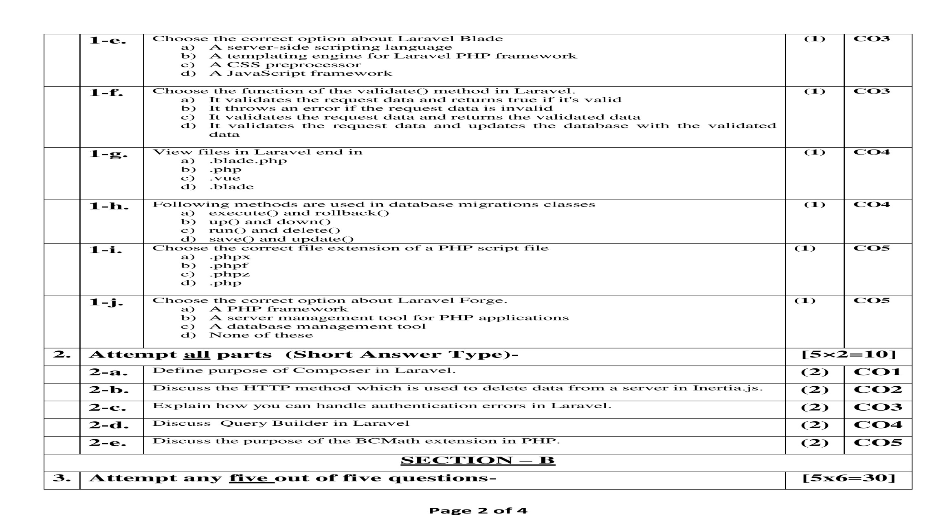
Old Question Paper

Slide 71
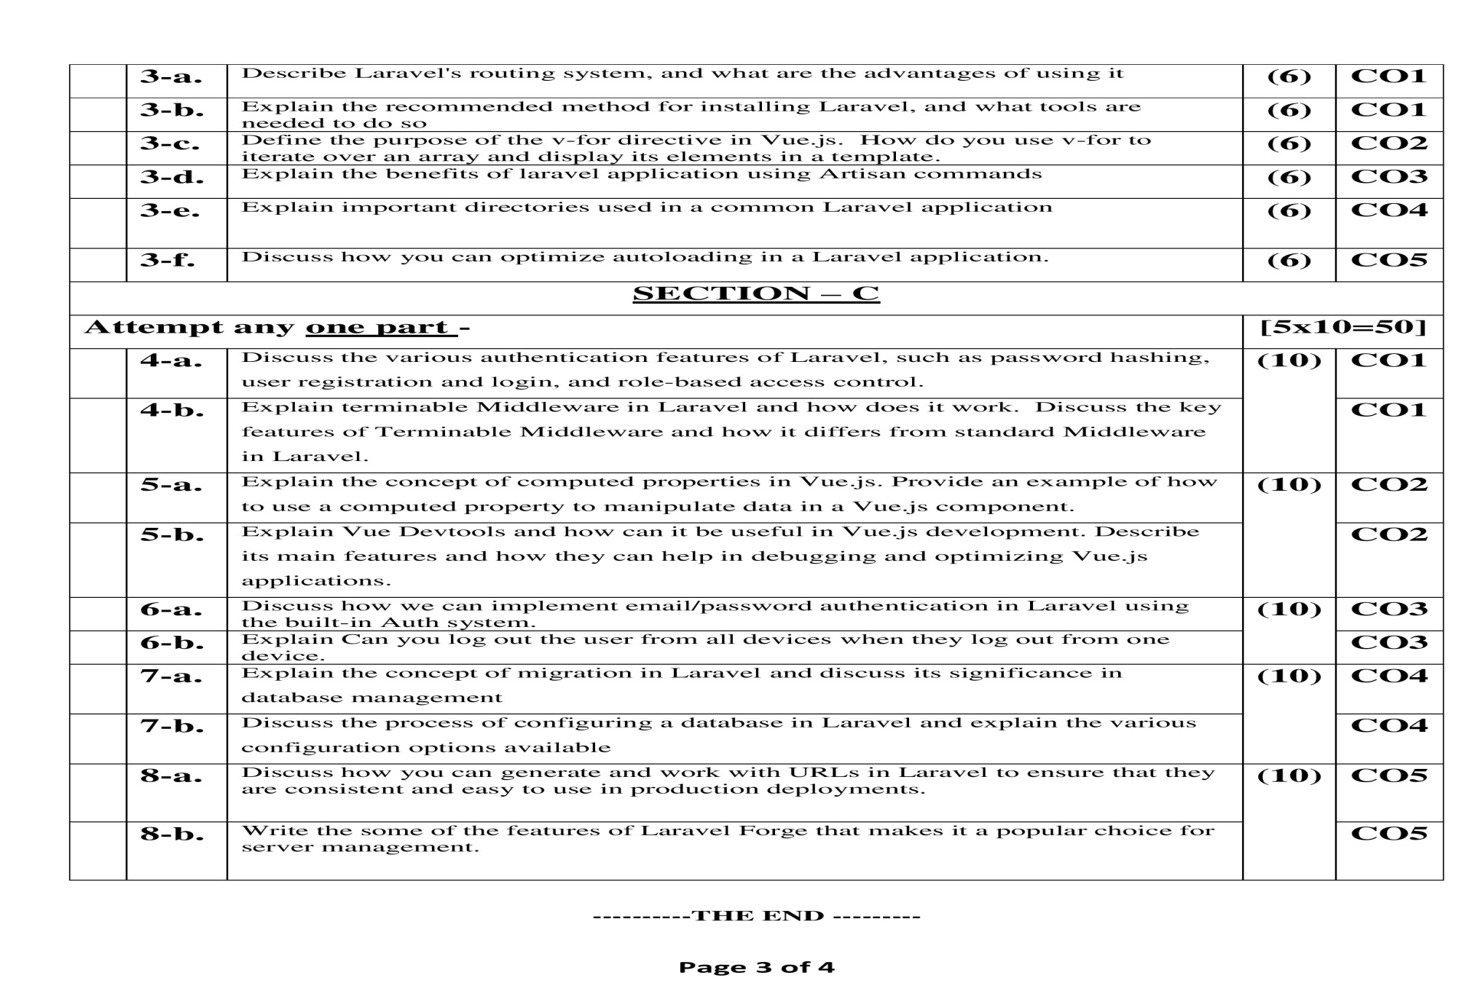
Old Question Paper

Slide 72
Topic Link ( YouTube & NPTEL Video Links)
YouTube /other Video Links
https://www.youtube.com/watch?v=5G1zxqFPKsA
https://www.youtube.com/watch?v=qJq9ZMB2Was
https://www.youtube.com/watch?v=98LrR740GNU

Slide 73
MCQ (End of Unit)
Which method returns the average value of a given key ?
average()
avg()
median()
avg_val()
2. Bootstrap directory in Laravel is used to
Initialize a Laraval application
Call laravel library functions
Load the configuration files
Load laravel classes and models
3. Which artisan command is used to remove the compiled class file.
clear-compiled
clear compiled
compiled:clear
clear:all

Slide 74
MCQ (End of Unit)
4. Which method breaks the collection into multiple, smaller collections of a given size
split()
chunk()
explode()
break()
5. Artisan command to flush the application cache:
cache:flush
cache:clear
cache:forget
cache:remove
6. The vendor directory contains
Laravel Framework code
Assets
Third-party code
Configuration files

Slide 75
Glossary Questions
What type of problems did you have working with Laravel or VueJS projects and how did you solve them?
What is Laravel Eloquent? Why is it nice to have for development?
How is the Vue Js Browser support these days?
What is your favorite feature of Laravel?
A project is using Laravel 6 and with LaravelShift could move to 7. Should it?
What is your favorite feature of Laravel?
Database Migrations - What is so useful about them?
What are Laravel Service Providers used for? Give an example in one of your projects?
What is your favorite feature of Laravel?
Axios Errors - How do you debug them? What tools do you use for it?

Slide 76
Expected Questions
Explain the term PHP Extension.
Write down in detail about BCMath and Ctype.
Explain the term Mbstring and OpenSSL.
Elaborate PCRE and PDO Server Configuration.
Write the need Route Loading.
Explain the term View loading.
Explain Autoloader Optimization in detail.

Slide 77
Recap of Unit
In this unit we studied about the deployment of Laravel Application for the production purposes.
We studied about the various types of PHP extensions like BCMath, Ctype, cURL, JSON and MBString etc.
We studied the concept of Laravel Server Management,
And optimization of view loading.
We studied how deployment with vapor takes place.

